Slide 1
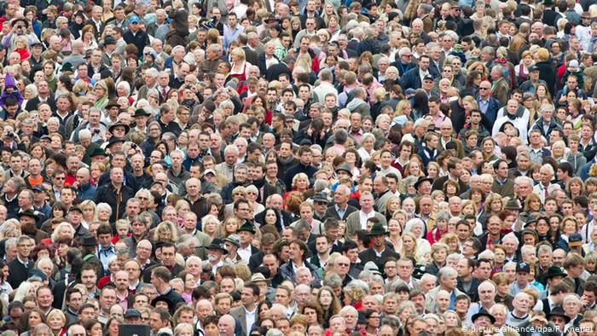
Kurdistan Region of Iraq
Population Analysis Report
وەزارەتی پلاندانان
June 2021

Slide 2
Objectives of the report
To provide a comprehensive population analysis of KRI and to describe the impact of population dynamics on sustainable development.
To inform decision makers on the implications of population dynamics on economic and social development.

Slide 3
Structure of the report
1. Introduction
2. Population size, trend, characteristics, and dynamics
3. Internal displacement and refugees
4. Population projections
5. Human capital
6. Sustainable development
7. Gender equality
8. Recommendations

Slide 4
Internally Displaced Population in KRI
Internally displaced population reached 1.1 million in 2016. More than half internally displaced households are originally from Ninewa Governorate and 20% from Salah-al-Din Governorate. Erbil and Sulaymaniyah host the most heterogeneous population, while most IDPs coming to Duhok are originally from Ninewa.
The KRI population in 2016, consisted of 1.1 million internally displaced persons (18% of the KRI population) and 200 thousand refugees (3% of the KRI population). The percentage of IDPs was higher in Duhok reaching 29% compared to 15% in Erbil and 10% in Sulaymaniyah. Among the 1.1 million IDP’s, Duhok hosts 625 thousand persons, i.e., 56% of all IDPs living in KRI.

Slide 5
Sulaymaniyah
Erbil
Erbil
1.1
million
201 thousand
Duhok
In 2016, Duhok hosted 718 thousands IDP and refugees: 50 % of its original population.

Slide 6
COVID-19 in KRI
Recent mortality trends were impacted by the COVID-19 pandemic which had a devastating impact on the health conditions in KRI.
As of June 4th, 2021, more than 172 thousand cases were confirmed since the outbreak of the pandemic.
92% of the cases cured from the disease and 4,308 deaths were attributed to COVID-19.
The burden of the pandemic varied across governorates. During 2020 the incidence rate per 100,000 was higher at Duhok (2,359 per 100,000) then Erbil (1,822 per 100,000) followed by Sulaymaniyah (1,407 per 100,000).
Number of deaths from COVID-19 are nearly 20% of the yearly deaths occurring before the pandemic.

Slide 7
2020-2040
Increase: 2.68 million
43%
7.5 million in 2030

Slide 8
KRI Population pyramid
2020
2040
4.6%
7.2%
60.7%
65.0%
34.7%
27.8%

Slide 9
Results from the population projections
 | 2020 | 2030 | 2040
Sex ratio (#males for every 100 females) | 101 | 101.5 | 102
Age dependency ratio (In non-working age/in working age) | 64% | 57% | 54%
Median age (half the population is younger than the median) | 22 | 25 | 28
Gross reproduction rate (average # of daughters per woman) | 1.51 | 1.36 | 1.22
Net RR (average # of daughters per woman + mortality effect) | 1.45 | 1.32 | 1.18
Mean age at childbearing | 29.1 | 28.8 | 28.7
Child-woman ratio (# of children below 5 per 100 women 15-49) | 47% | 41% | 37%
Crude birth rate (# births per 1000 inhabitants) | 24.8 | 22.3 | 19.1
Expected number of births | 153,076 | 166,924 | 168,635
Crude death rate (# deaths per 1000 inhabitants) | 4.3 | 4 | 4.4
Expected number of deaths | 26,611 | 30,213 | 38,551
Rate of natural increase (%) | 1.93 | 1.65 | 1.36
Doubling time (duration to double in size if growth rate persists) | 34.2 | 38.4 | 47.5

Slide 10
Implications of population dynamics on sustainable development
 | 2020 | 2030 | 2040 | Change 2020 to 2030 | Change 2030 to 2040
Population 0-4 | 757,213 | 805,272 | 829,660 | 6.3 | 3.0
Population 5-14 | 1,379,451 | 1,519,691 | 1,626,533 | 10.2 | 7.0
Population 15-24 | 1,228,950 | 1,375,408 | 1,516,147 | 11.9 | 10.2
Population 15-64 | 3,753,047 | 4,767,264 | 5,751,659 | 27.0 | 20.6
Population 65+ | 281,372 | 408,927 | 639,712 | 45.3 | 56.4
Females 15-49 | 1,613,054 | 1,953,735 | 2,245,345 | 21.1 | 14.9
Population 6-11 | 829,400 | 923,669 | 982,991 | 11.4 | 6.4
Population 12-14 | 407,819 | 439,352 | 477,576 | 7.7 | 8.7
Population 15-17 | 411,814 | 421,786 | 464,152 | 2.4 | 10.0
 | Room for improving quality |  | More resources needed |  | Large increase in resources needed

Slide 11
Implications of population dynamics on sustainable development
 | Change 2020 to 2030 | Change 2030 to 2040 | Program
Population 0-4 | 6.3 | 3.0 | Childcare
Population 5-14 | 10.2 | 7.0 | Adolescence programs
Population 15-24 | 11.9 | 10.2 | Youth programs & employment
Population 15-64 | 27.0 | 20.6 | Employment
Population 65+ | 45.3 | 56.4 | Elderly care & geriatrics
Females 15-49 | 21.1 | 14.9 | Reproductive health
Population 6-11 | 11.4 | 6.4 | Education
Population 12-14 | 7.7 | 8.7 | Education
Population 15-17 | 2.4 | 10.0 | Education
 | Room for improving quality and/or equity |  | More resources needed to improve quality or equity |  | Maintaining service delivery is challenging |  | Maintaining service delivery is extremely challenging

Slide 12
Demographic dividend
A demographic dividend is the accelerated economic growth that can result from improved reproductive health, a rapid decline in fertility, and the subsequent shift in population age structure.
With fewer births each year, a country’s working-age population grows larger relative to the young dependent population.
With more people in the labor force and fewer children to support, a country has a window of opportunity for economic growth if the right social and economic investments and policies are made in health, education, governance, and the economy.

Slide 13
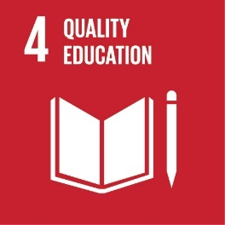
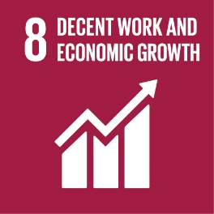
Demographic dividend and sustainable development goals
Educate
Empower
Employ
Ensure inclusive and equitable quality education and promote lifelong learning opportunities for all
Ensure healthy lives & promote well-being for all at all ages
Achieve gender equality and empower all women and girls
Promote sustained, inclusive, & sustainable economic growth, full & productive employment, & decent work for all

Slide 14
HUMAN CAPITAL PROJECT – World Bank
 | EDUCATION
SURVIVAL | HUMAN CAPITAL | HEALTH
 | NUTRITION
Human capital consists of the knowledge, skills, and health that people accumulate throughout their lives, enabling them to realize their potential to become productive members of society. Investing in people through nutrition, health care, quality education, jobs and skills helps develop human capital, and this is key to ending extreme poverty and creating more inclusive societies.
Promote effective investments in people, which increases productivity and economic growth, as well as accelerated progress toward the SDG’s.

Slide 15
HUMAN CAPITAL INDEX and SDG’s
Increase # youth and adults with relevant skills for employment, decent jobs & entrepreneurship.
Build and upgrade education facilities.
Increase the supply of qualified teachers.
Reduce the proportion of youth not in employment, education or training.
End preventable deaths of children under 5.
Reduce maternal mortality.
Reduce the number of deaths and injuries from road traffic accidents.
 | EDUCATION
SURVIVAL | HUMAN CAPITAL | HEALTH
 | NUTRITION
Achieve universal health coverage.
Ensure universal access to sexual and reproductive health care services
Strengthen tobacco control.
End all forms of stunting and wasting in children under 5 years of age.

Slide 16
Recommendations

Slide 17
1. Population dynamics and sustainable development
Population analysis (including population projections) should be an integral part of economic and social plans. Population dynamics is pointing out to:
Between 2020 and 2040, the population of KRI is expected to increase by 2.7 million. The increase is equally divided between the two decades.
Increase of 12% in adolescents and youth 15-24 between 2020 and 2030, followed by an increase of 10% during the following decade,
Increase of 27% in labour force (15-64) between 2020 and 2030, and 21% between 2030 and 2040,
Increase of 11%, 8% and 2% of children who should be enrolled in primary, preparatory and secondary education between 2020 and 2030. During the following decade, the rate of change will change to 6%, 9% and 10%,
Increase in females in reproductive age of 21% and 15% in the 2020’s and 2030’s respectively, and,
Increase in aging population (65+) of 45% between 2020 and 2030 and of 56% between 2030 and 2040.

Slide 18
2. Sustainable development goals
KRI indicators shows the following areas for improvement:
Social protection [% of households that have benefited from any Social transfers KRI: 24%, Iraq: 35%]
Using modern contraceptives, [KRI 26%, Iraq: 36%],
Female genital mutilation [women (15 -49) with FGM, KRI: 37% , Iraq: 7%] , and,
Child labour [KRI: 10%, Iraq: 5%].
Source: MICS Survey 2018

Slide 19
3. Population policy and institutional framework
Designing a new population policy for KRI along with the establishment of a higher population council can provide a comprehensive approach to population challenges and can integrate population goals and sustainable development goals. For this approach to succeed, it is necessary to have:
A comprehensive and participatory vision for population,
A higher population council that is empowered, inclusive and efficient,
A clear responsibilities and accountability mechanism, and,
A strong monitoring and evaluation system.

Slide 20
4. Women empowerment
Expanding the care economy in KRI with all its components can contribute to increase women economic participation as it will reduce the double burden on working women. In the meanwhile, it will increase job opportunities for women as females are more qualified to work in the care economy sector. Such shift from unpaid to paid care will improve the quality of education and then will contribute to human capital. Furthermore, it will improve the quality of care provided to the elderly and to people with disability. Finally, the care economy is an opportunity for the growth of the private sector and can partially diversify the economy by increasing the growth of non-oil sectors.

Slide 21
5. Data gaps
There is a need for KRI to collect data and produce indicators to be able to draft policies and design interventions that are evidence-based specifically in the following areas:
Updated information on IDPs and refugees,
Updated SDG and human capital indicators,
Reproductive preferences and intentions for migration among youth,
Child labour,
Unmet needs from family planning services and method mix, and,
Maternal mortality (survey / registry.)

Slide 22
6. Further research
The following areas of research need to be considered to support decision-makers:
Tying population dynamics to sustainable development goals,
Localizing sustainable development goals for KRI,
Elaborate analysis of the results of the forthcoming census,
Demographic dividend in KRI,
Determinants of maternal mortality and,
Impact of COVID-19.

Slide 23
Thank You
magued.osman@baseera.com.eg

